Slide 1
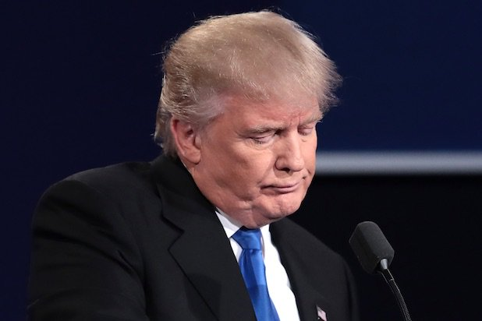
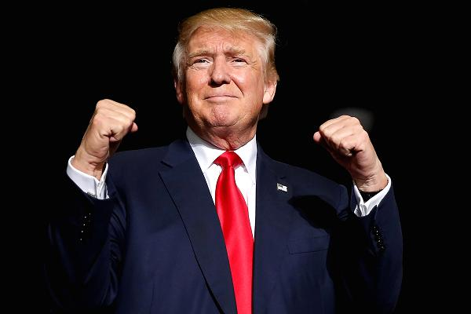
Trump Presidency: Successes and Failures One Year In
Artemus Ward
Dept. of Political Science
Northern Illinois University
aeward@niu.edu

Slide 2
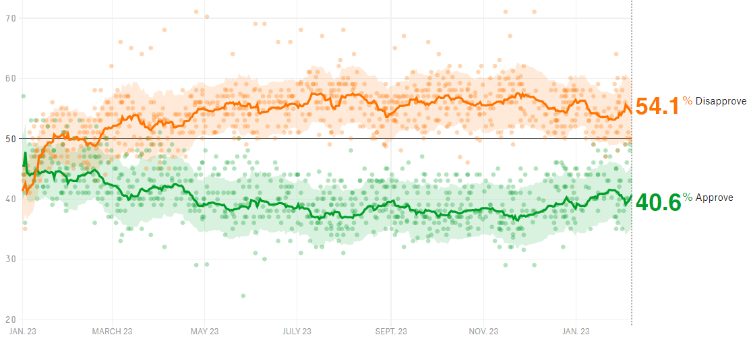
Only 4 in 10 Americans say they approve of the way Trump is handling his job.
Trump’s approval rating is far lower than any president at this point in his presidency in 7 decades of polling.

Slide 3
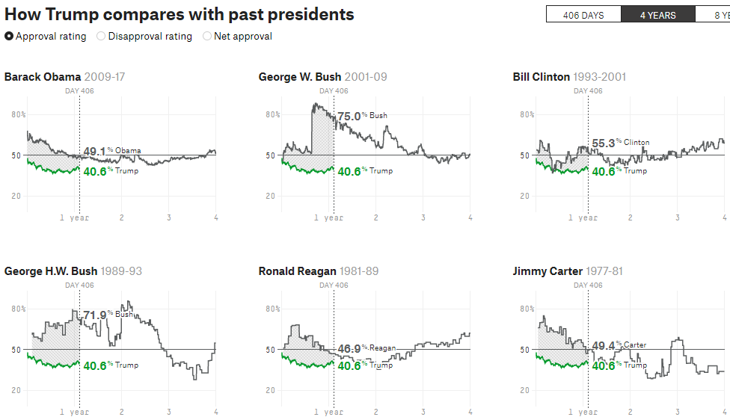

Slide 4
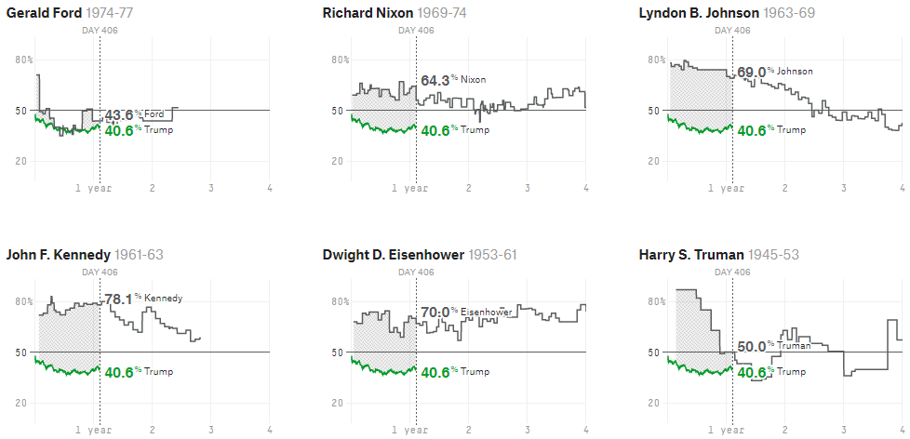

Slide 5
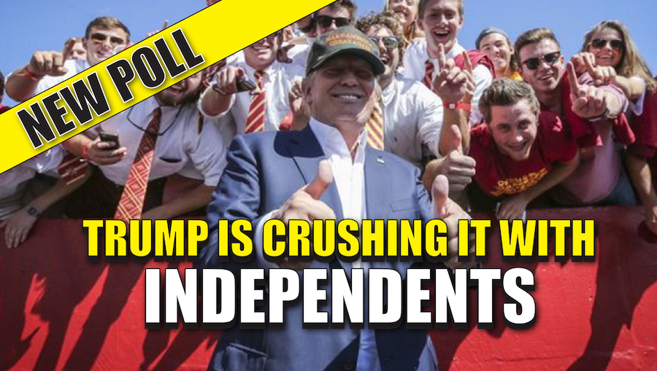
Trump is Losing Independents
Political independents have soured the most considering Trump’s pre-inaugural expectations and current ratings.
The percentage of independents approving of Trump is roughly 35%.
Democrats approving of Trump are in single digits, roughly 5%.
But Trump remains popular with Republicans, polling roughly 80% approval.

Slide 6
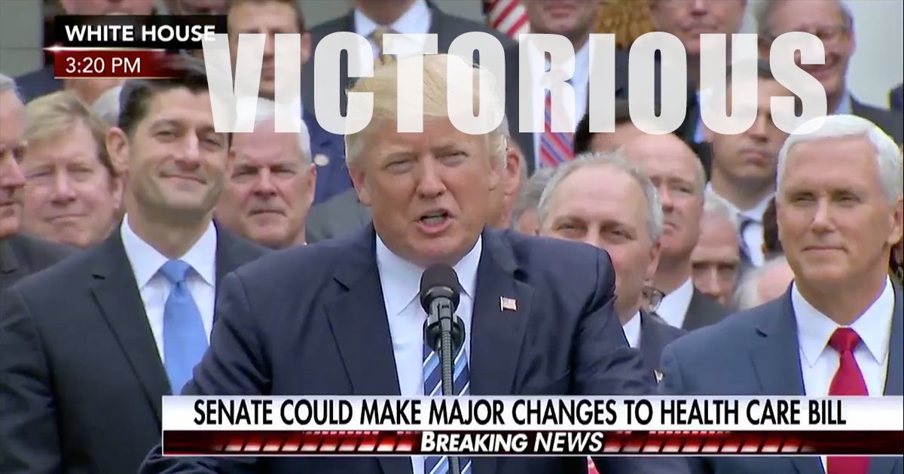
Failure: Health Care
Despite his party controlling congress, and despite a House-passed bill that Trump celebrated at a Rose Garden ceremony (but later called “mean”) Trump and the GOP failed to pass health care legislation after repeatedly trying.
However, Trump did sign a tax bill in 2017 that eliminated the individual mandate that requires everyone to have health insurance or pay a tax penalty.
Trump issued an executive order to end a key set of Obamacare subsidies that helped lower-income enrollees pay for health care. Nearly 6 million enrollees, or 57%, qualified for the cost-sharing payments this year. The subsidies cost the federal government about $7 billion in 2017.
The uncertainty over the subsidies' fate was a key reason that many insurers substantially hiked their rates for 2018 -- some by more than 20%. Several major carriers dropped out of the individual market, unwilling to wait and see what Trump and congressional Republicans would do. With the individual mandate gone, insurers are even more nervous about their ability to participate in what remains of the Affordable Care Act (Obamacare).
Will the American people consider the repeal of the mandate and the executive orders a “success” on health care given what Trump promised during the campaign (affordable health care for all)?

Slide 7
Failure: Muslim Travel Ban
Early in his administration, Trump issued an executive order attempting to ban Muslims from entering the U.S. throwing airports into chaos and prompting demonstrations.
Initially, the list of countries subject to the ban were all predominantly Muslim: Iran, Iraq, Libya, Somalia, Sudan, Syria, and Yemen.
But courts essentially blocked the ban, which the administration has revised multiple times to try to satisfy them—most notably by adding Chad (a U.S. ally) and the non-Muslim nation of Venezuela to the list of nations included in the ban.
The U.S. Supreme Court will hear arguments this term and decide whether the ban violates immigration law and the Establishment Clause of the Constitution.

Slide 8
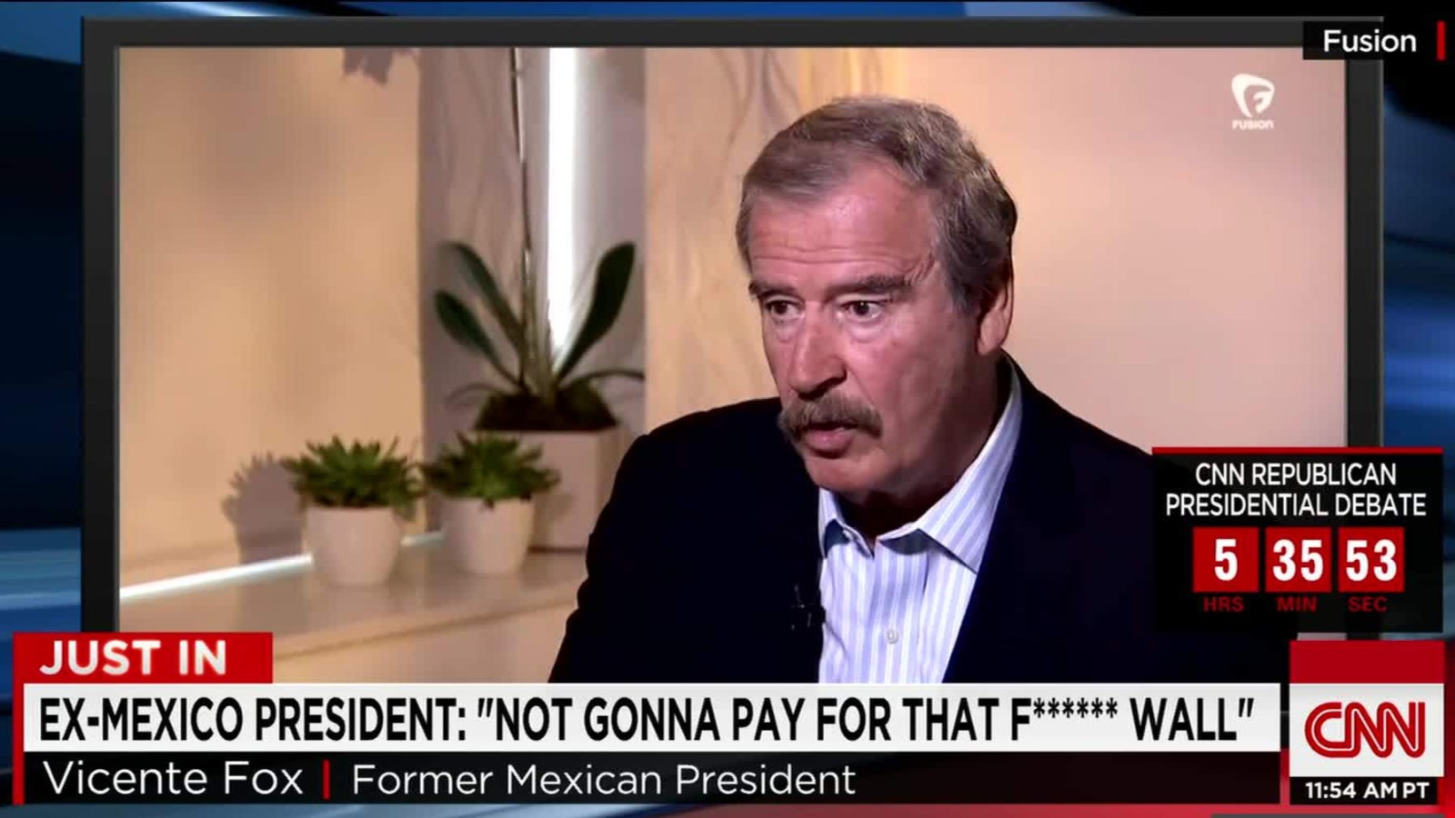
Failure: Building a Wall on the Mexican Border
Trump promised to build a wall on the Mexican border and force Mexico to pay for it.
Not only has that not happened but the GOP-controlled congress has not appropriated funding for a wall.
Was it ever realistic for voters to believe that a 2,000-mile physical structure spanning sea to sea was going to be constructed?

Slide 9
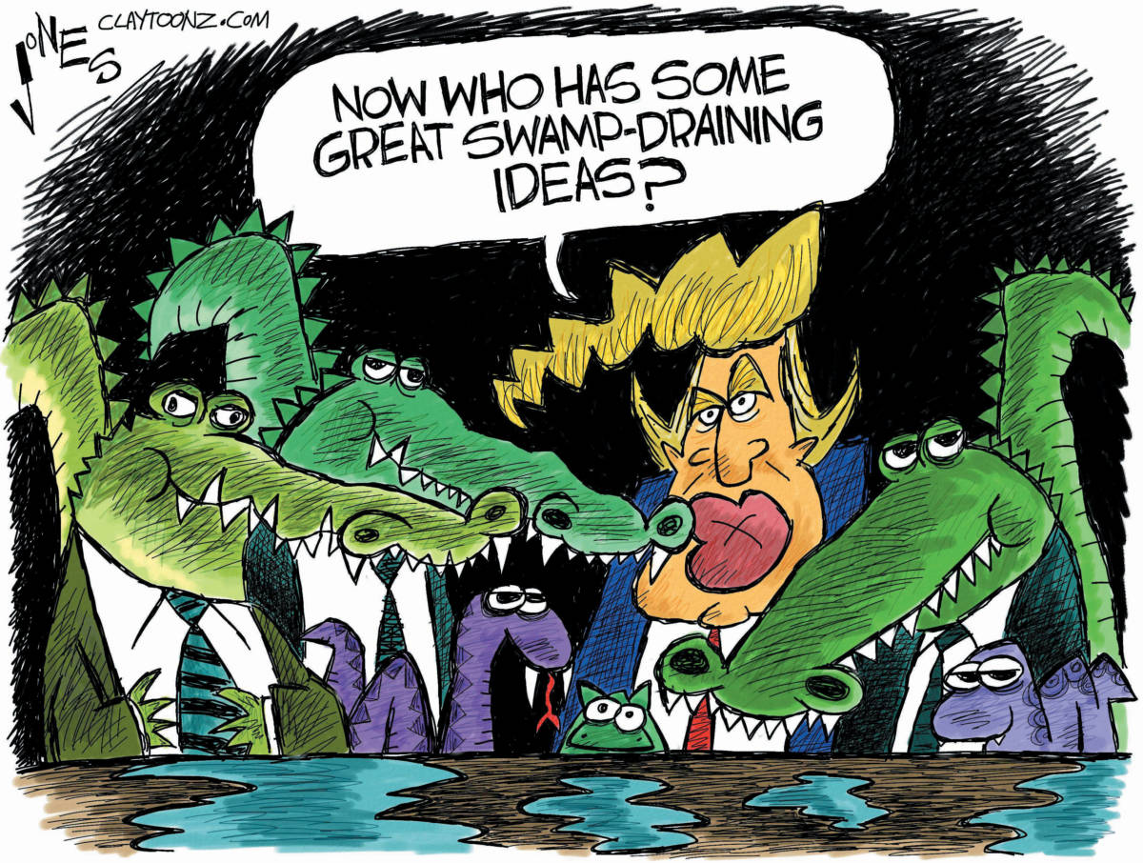
Failure to Drain the Swamp
Trump won the election in part by promising to do things differently, to shake up the existing order and to rid Washington of its cozy elite.
But his administration of wealthy businessmen, generals, and Goldman Sachs executives looks like the same old cronies to many Americans.
Even Steve Bannon, the former head of Breitbart News and the populist rabble rouser in the Trump campaign and West Wing, is an alumnus of Goldman Sachs, the bank once condemned by Trump for epitomizing the close ties between Wall Street and politics.
In 2017, Trump signed a tax bill that will expand the nation’s debt by at least $1 trillion.
Trump has called for the return of earmarks to help get legislation passed. Earmarks are pork-barrel spending provisions for projects favored by individual members of congress to benefit their contributors (a type of bribery) in return for the member’s support on a larger spending bill (e.g. the “Bridge to Nowhere”). Speaker Pelosi imposed a moratorium on earmarks in 2007 and Speaker Boehner banned them altogether in 2011.
Trump’s, and the American people’s, lack of historical knowledge about issues undermines the nation’s ability to learn from its mistakes.

Slide 10
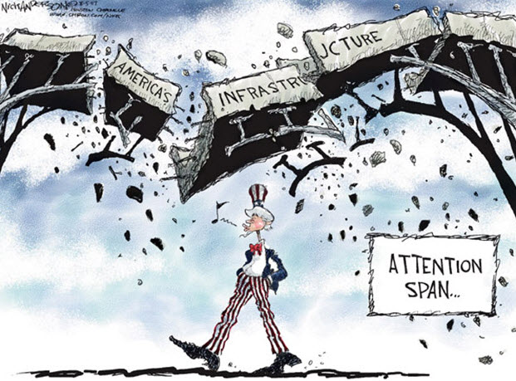
Failure: Infrastructure Bill
Like the wall, Trump had promised to get it moving as part of his grand 100-day plan. One year into his presidency, he finally proposed $200 billion in federal spending to (hopefully) spur state and local governments to spend $2 trillion on infrastructure.
Will this pass, and if so, will it work?

Slide 11
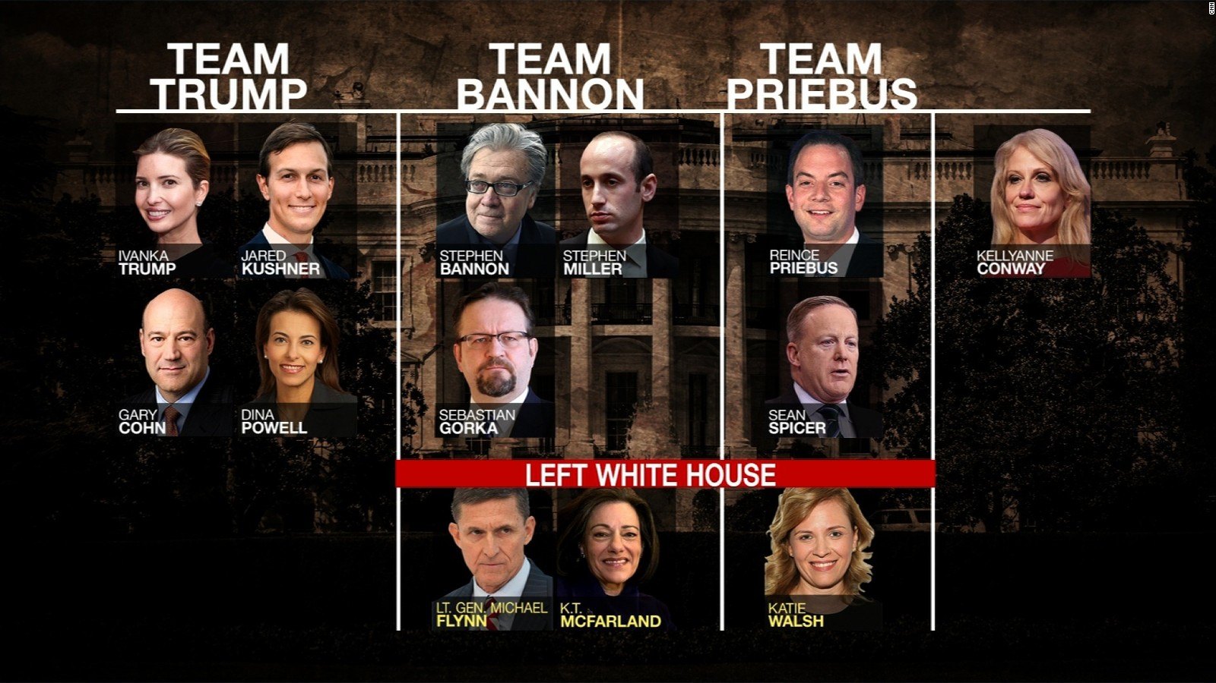
Failure: White House Infighting, Staffing Issues
For days at a time, press coverage of Trump’s presidency have been dominated by tensions between his key advisers. Clashes among his staffers have frequently offered an image of a White House paralyzed by infighting.
Purges of Steve Bannon, Michael Flynn, Reince Priebus, Sean Spicer, Anthony Scaramucci, Hope Hicks, and others have not quelled the internal leaks and maneuvering for power and influence in the Trump White House.
Trump’s 34% turnover rate of White House staffers (50 people) in his first year is more than three times as high as Obama’s in the same period and twice as high as Reagan’s, which until now was the modern record-holder.
Of 12 positions deemed most central to the president, after Trump’s first year in office only 5 were still filled by the same person that initially held the job: two chiefs of staff, two press secretaries, three deputy national security advisers, five communications directors; fired chief strategist, health secretary, several deputy chiefs of staff and the president’s original legal team. Others remain like the secretary of state and attorney general even after the president attacks them and makes plain that he has no confidence in them.
Furthermore, the Trump administration has made the fewest nominations and has had the fewest confirmed one year into his presidency than the last five administrations. For example, at the State Department, nominees were not made for three under secretary positions and 10 assistant secretary positions, senior level jobs that have traditionally been crucial to managing foreign policy.

Slide 12
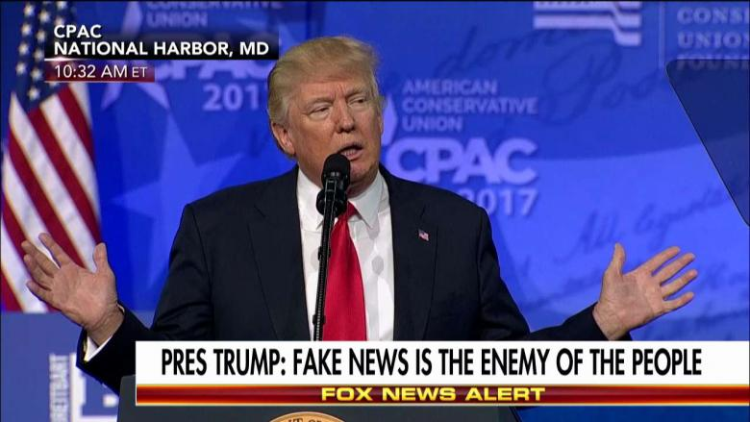
Failure: Undermining American Institutions & Norms
Perhaps Trump’s biggest failure is how his rhetoric and behavior undermines American institutions and norms and smacks of authoritarian kleptocracy:
Using the presidency to personally enrich himself and his family through their private businesses.
Pressuring the Justice Dept. and FBI to by loyal to him, pursue cases against his political adversaries, and calling for punishment before trials take place.
Praising and embracing authoritarian regimes around the world (Russia, Saudi Arabia, Turkey, Egypt, Philippines, etc.) while criticizing western democracies (Britain, Germany).
Attacking the free press and asserting that the most venerated, prestigious, objective and trustworthy news organizations in the nation are “fake news.”
Increasingly making false and misleading statements at such an unprecedented level (nearly 90% of what he says, over 2,000 in his 1st year in office, an average of over 5 times per day) that conspiracy theories, cynicism, and distrust of government are at record highs.

Slide 13
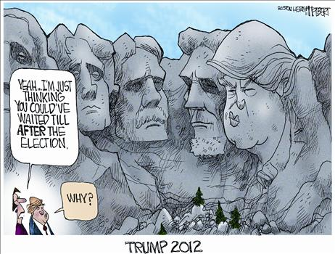
Failure: The Judgment of History
Political scientists who are experts on the presidency, ranked American presidents for greatness, including Trump (albeit with only one year in office).
Where was Trump ranked historically? Last.
He ranked far lower than the only president to resign in history (Nixon), the impeached president Andrew Johnson, and the presidents who served in the run-up to the Civil War (Pierce and Buchanan).
Trump did not fare well even when parsing the results by party and ideology. He ranked 40th out of 44 among Republicans and conservatives. Why?

Slide 14
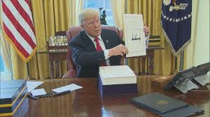
Success: Tax Overhaul
On Dec. 22, 2017, Trump signed the “Tax Cuts and Jobs Act” into law.
The law cuts corporate tax rates permanently from the top rate of 35% to 21% across the board.
The law lowers the tax brackets for nearly all individual filers, temporarily. The highest earners are expected to benefit most from the law, while the lowest earners may actually pay more in taxes once most individual tax provisions expire after 2025.
The law abolishes the personal exemption ($4,150 in 2018) but raises the standard deduction to $24,000 for married couples filing jointly in 2018 (from $13,000 under current law), to $12,000 for single filers (from $6,500), and to $18,000 for heads of household (from $9,550). These changes expire after 2025.
It permanently removes the individual mandate, a key provision of the Affordable Care Act, which is likely to raise insurance premiums and significantly reduce the number of people with coverage.
It cuts the state and local tax deduction hurting taxpayers in high-tax states like California, New York and New Jersey.
The overhaul is forecast to raise the federal deficit by hundreds of billions of dollars – and perhaps as much as $2.0 trillion – over the coming decade.

Slide 15
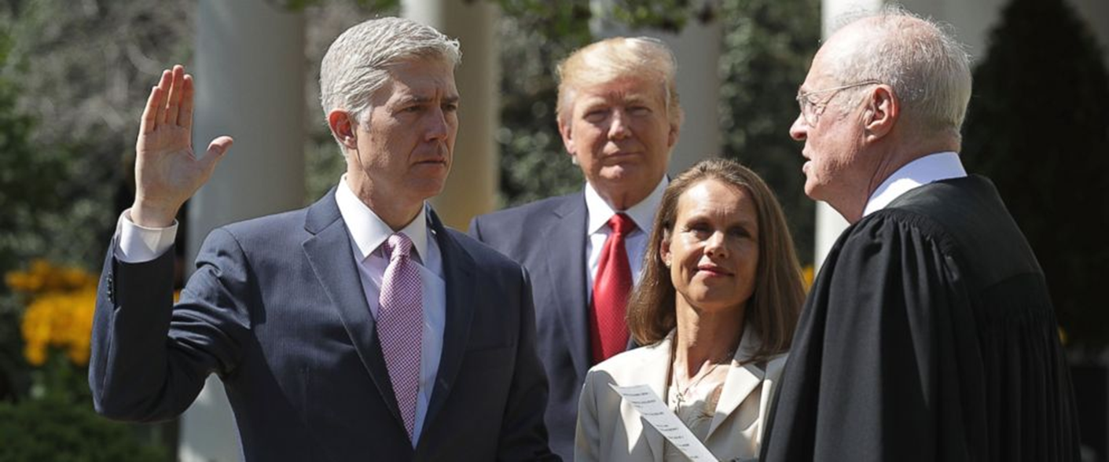
Success: Supreme Court Justice Neil Gorsuch
Trump’s election kept conservative Antonin Scalia’s vacant seat away from the Democrats and Trump’s nominee—the most conservative justice in half a century—was easily confirmed by the GOP-controlled Senate.
Should Reagan-appointee, moderate conservative Anthony Kennedy depart under Trump (as is rumored) any justice with a conservative bent (including a moderate conservative like Kennedy) will be yet another Trump success because it is a seat the Democrats will not be able to control.

Slide 16
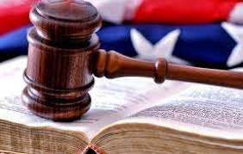
Success: Packing the Federal Courts with Conservatives
Conservatives are quietly engaged in court-packing plan where President Trump will add twice as many lifetime members to the federal judiciary in two years (650) as President Obama named in eight years (325).
In the final two years of Obama’s presidency, Senate Republicans engaged in tenacious obstruction to leave as many judicial vacancies unfilled as possible. Also, conservative federal judges waited to time their “retirements” for a GOP president.
Trump is wasting no time in filling the 103 judicial vacancies he inherited. In the first 9 months of Obama’s tenure, he nominated 20 judges to the federal trial and appellate courts; in Trump’s first 9 months, he named 58. Senate Republicans are racing these nominees through confirmation.
In addition to the still-defunct filibuster for lower-court nominees, in Nov. 2017, breaking a 100-year-old tradition, the Senate GOP eliminated the “blue slip” rule that allowed home-state senators to object to (and therefore block) particularly problematic nominees.
The rush to Trumpify the judiciary includes nominees rated unqualified by the American Bar Association, nominees with extreme conservative views, nominees more white and male than have been selected in 30 years, and nominees significantly younger (and, therefore, likely to serve longer) than those of previous presidents.
As a result, by sometime in 2018, 1 in 8 cases filed in federal court will be heard by a judge picked by Trump. Many of these judges will likely still be serving in 2050.

Slide 17
Success: Packing the Federal Courts with Conservatives
Furthermore, there is a GOP plan in the works to increase the number of federal judgeships by 30-50%.
In addition, the plan calls for Congress to abolish 158 administrative law judgeships in federal regulatory agencies, such as the Environmental Protection Agency, Food and Drug Administration, Federal Communications Commission, and Securities and Exchange Commission, and replace these impartial fact-finders with a new corps of 158 Trump-selected judges who — unlike current administrative law judges — would serve for life.
Unlike the existing administrative law judges, selected as nonpartisan members of the civil service, this new replacement corps would all be picked in a single year, by a single man: Donald J. Trump.

Slide 18
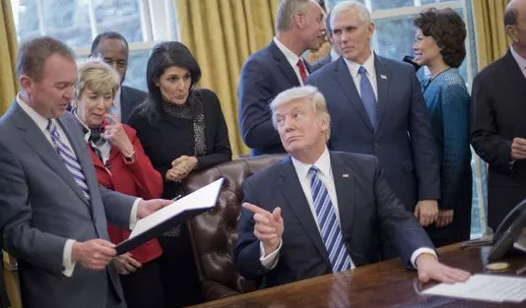
Success: Government Deregulation
Government Regulations – The administration vowed to “deconstruct the administrative state.” They succeeded in placing people hostile to government regulations in key cabinet positions, withdrawing many more regulations than recent presidents in their first terms, and rolled back 14 rules under the Congressional Review Act (1996) that Obama issued at the end of his administration (the time limit for using the law expired in May, but it had only been used once before, under Bush).
Although it is true that President Trump signed an executive order on 13 March 2017 directing the heads of executive branch departments to eliminate all “unnecessary” agencies and reorganize those that remain to improve their “efficiency, effectiveness, and accountability,” the order gave said department heads six months from the date of signing to come up with suggestions for this process, so not much fat has been trimmed thus far despite the groundwork being laid. Plus Trump promised to abolish the EPA but it still exists.
It is worth recalling that important segments of the economy, such as the airline, trucking and railroad industries, were deregulated in the 1970s, 1980s and 1990s. The deregulatory push ultimately led Congress in 1995 to mothball the 108-year-old Interstate Commerce Commission, the nation’s first regulatory agency. Such actions are not be easily identified by counting regulations that are eliminated — and arguably may have greater economic impact than repealing individual rules.

Slide 19
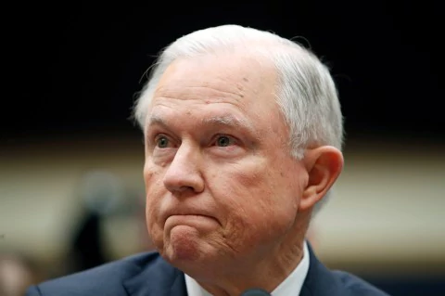
Success: Criminal Justice
Attorney General Jeff Sessions has implemented a new charging and sentencing policy that calls for prosecutors to pursue the most serious charges possible, even if that might mean minority defendants face stiff, mandatory minimum penalties.
Sessions adjusted the DOJ’s legal stances in cases involving voting rights and lesbian, gay, bisexual and transgender issues in a way that advocates warn might disenfranchise poor minorities and give certain religious people a license to discriminate.
In February, the DOJ dropped its stance that Texas intended to discriminate when it passed its law on voter identification. And in August, it sided with Ohio in its effort to purge thousands of people from its rolls for not voting in recent elections.
Sessions recently issued 20 principles of guidance to executive-branch agencies about how the government should respect religious freedom, including allowing religious employers to hire only those whose conduct is consistent with their beliefs. About the same time, he reversed a three-year-old Justice Department policy that protected transgender people from workplace discrimination by private employers and state and local governments.

Slide 20
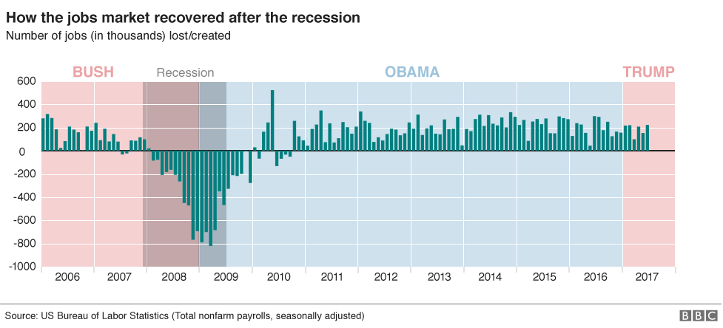
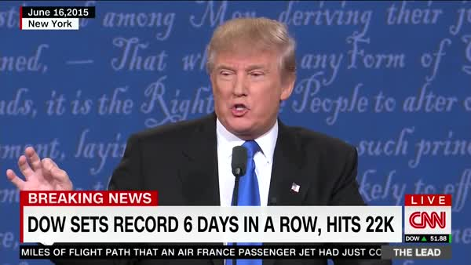
Success: The Economy
Trump routinely takes credit for the economy—specifically record stock market gains and relatively low unemployment. Consumer confidence is also up.
So does Trump deserve any credit for solid economic results? If you think the economy is driven by concrete, specific policies around taxes, spending, monetary policy and regulation, the answer is no. If you think that what really matters is the mood in the executive suite, then perhaps.
It is also true that there is a shrinking middle class, greater wealth inequality in the U.S. since before the Great Depression, and the unemployment rate does not count underemployed and those no longer looking for jobs (something Trump used to point out when he claimed the actual unemployment rate was 40% under Obama).
Regardless of whether Trump is actually responsible for it, presidents are judged by the American people on the state of the economy.

Slide 21
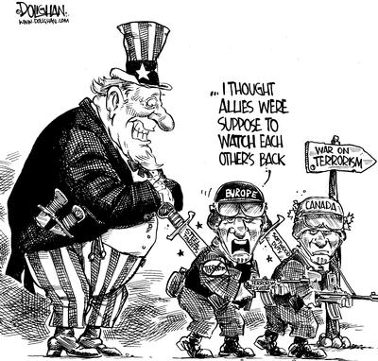
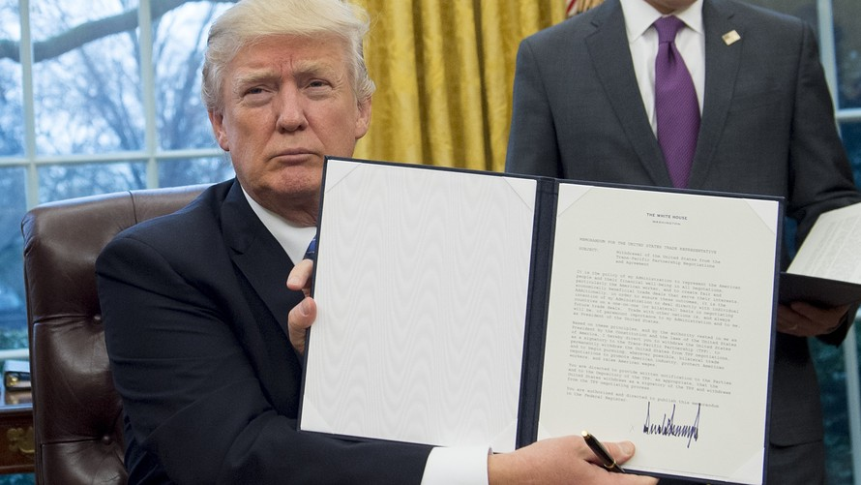
Success: Protectionism
During the campaign Trump promised to protect American businesses by imposing taxes on foreign importers of competing products (tariffs).
In Apr 2017 the administration announced a tariff on Canadian lumber
In Sep 2017 the president imposed tariffs on Canadian-made planes (Bombardier).
In Jan 2018 Trump slapped duties of as much as 30% on solar equipment made outside the U.S. and as much as 50% on washing machine imports.
In Mar 2018 Trump announced that he would impose tariffs on imports of steel (25%) and aluminum (10%).
The metal tariffs would fall most heavily on America’s traditional allies, such as Canada, the European Union (Germany), and South Korea. These nations said if the president follows through they may have no choice but to respond with their own tariffs on American exports.
“Trade wars are good and easy to win.” He tweeted.

Slide 22
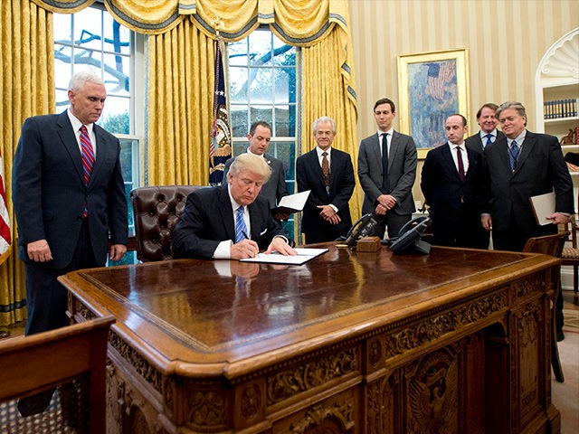
Success: Killing the Trans-Pacific Partnership
Trump fulfilled a campaign promise by signing an executive order withdrawing the U.S. from the Trans-Pacific Partnership (TPP) international trade agreement on 23 January 2017, one day after announcing he would renegotiate it.
Despite President Obama’s fervent support for the deal, many groups, including labor unions, were critical of the TPP, and CNN reported that its chances of approval by Congress were already “bleak.”

Slide 23
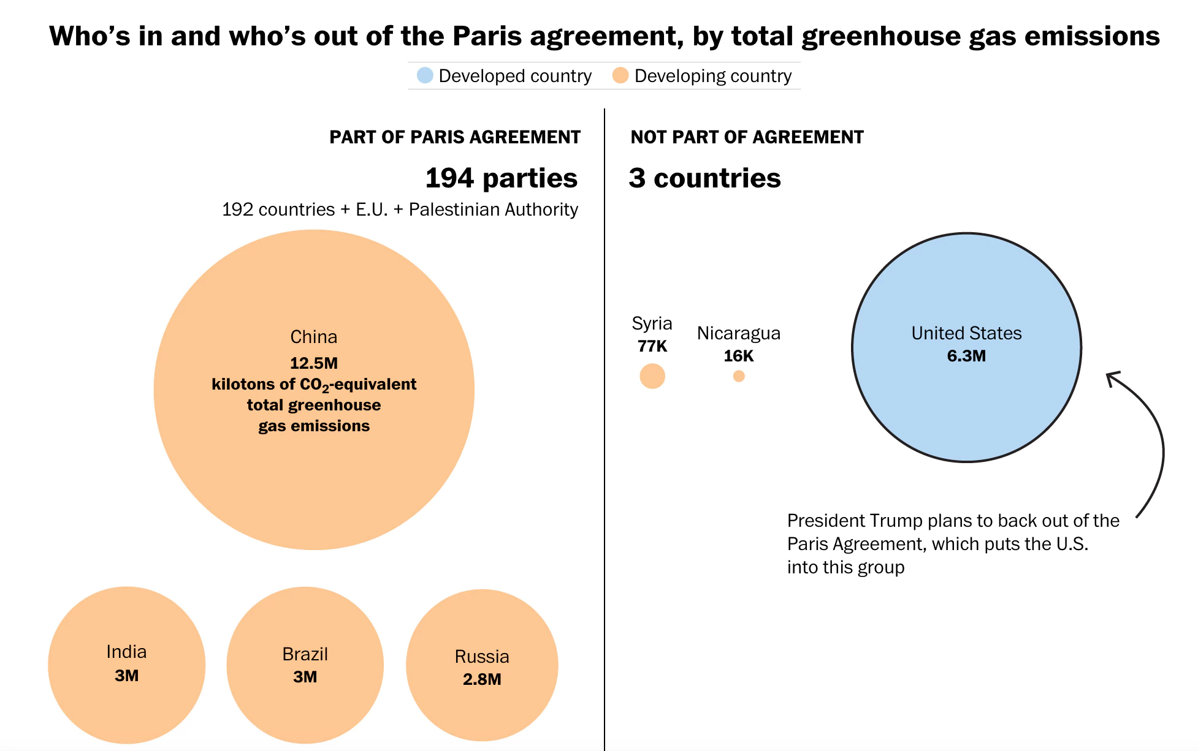
Success: Withdrawing from the Paris Climate Accord
2
The decision to withdraw from the Paris accord came this summer as the White House was preparing to rewrite Obama-era rules that were supposed to curb greenhouse gas emissions.
U.S. officials feared that being both part of the Paris climate agreement and seeking to reverse some of those curbs could have weakened the U.S. government’s position in future lawsuits.
Still, a new, unofficial U.S. coalition, “We Are Still In,” is a 2,500-member alliance of American voices from businesses, state and local governments, and universities committed to the U.S. greenhouse gas reduction targets.

Slide 24
Success: Pipelines & National Monuments
The controversial Dakota Access Pipeline project, halted under President Obama, was revived by President Trump and began operations on 1 June 2017. Trump also revived the Keystone XL Pipeline project but it is currently tied up on the courts.
Trump also issued an executive order directing a review of lands designated as national monuments. Specifically, the review will consider all national monument designations of federal public lands since 1996 that are 100,000 acres or larger. Trump singled out Obama’s “egregious” use of federal power in using the Antiquities Act (1906) to “unilaterally” place swaths of American land and water under federal control, adding, “it’s time we ended this abusive practice.”
Every president since Theodore Roosevelt has used that act to designate monuments including Reagan (Mount St. Helens; El Malpais in New Mexico; Poverty Point in Louisiana; Hagerman Fossil Beds in Idaho), Bush I (Petroglyph in New Mexico; Newberry Volcano in Oregon; Grand Staircase-Escalante in Utah), and Bush II (African Burial Ground in New York; Papahānaumokuākea Marine and Pacific Remote Islands Marine in the Hawaiian Minor Outlying Islands; World War II Valor in the Pacific in Hawaii, Alaska, and California; Marianas Trench Marine in Guam; Rose Atoll Marine in American Samoa).
But this would allow Trump to undo all major designations from the Clinton and Obama administrations.
Clinton’s designations: Grand Staircase-Escalante in Utah; Grand Canyon-Parashant, Ironwood Forest, Vermilion Cliffs, and Sonoran Desert in Arizona; Giant Sequoia, Santa Rosa and San Jacinto Mountains, Carrizo Plain in California; Hanford Reach in Washington; Canyons of the Ancients in Colorado; Ironwood Forest in Arizona; Upper Missouri River Breaks in Montana;
Obama’s designations under review: Bears Ears in Utah; Northeast Canyons and Seamounts off the coast of New England; Mojave Trails, Berryessa Snow Mountain, San Gabriel Mountains in California; Basin and Range in Nevada; Organ Mountains-Desert Peaks, Rio Grande del Norte in New Mexico.

Slide 25
Success: Immigration
While a literal wall is unlikely to be built, Trump is building a virtual wall by his actions and rhetoric.
He has moved to slash the number of refugees, accelerate deportations and terminate the provisional residency of more than a million people, among other measures.
Trump has endorsed GOP legislation to cut annual, legal immigration by half, reducing the number of green cards issued annually from about 1 million to 500,000. More weight would be given to immigrants with job skills, as opposed to those with extended family in the U.S.
The president cut the number of refugees the U.S is willing to accept annually from 110,000 to 45,000, the lowest level since 1980, and ordered the implementation of a time-consuming “extreme vetting” system that could mean the number of refugees cleared each year is much lower. In Oct. 2017, 1,242 refugees arrived in the U.S., down from 9,945 in Oct. 2016.
Trump also eliminated a smaller program specifically for refugees fleeing violence in Central America. The Pentagon, citing concerns about vetting, suspended a recruitment program offering skilled foreigners a fast track to citizenship if they serve in uniform.
In Nov. 2017, the government declined to renew Temporary Protected Status, a form of provisional residency, for about 2,500 Nicaraguans. The State Department says conditions in Central America and Haiti that had been used to justify the protection for as long as two decades no longer necessitate a reprieve. Decisions on more than 250,000 Hondurans and Salvadorans with the provisional residency permits are pending.
In November 2017, the Department of Homeland Security said nearly 60,000 Haitians allowed to stay in the U.S. after a devastating 2010 earthquake have until July 2019 to leave or obtain another form of legal status.

Slide 26
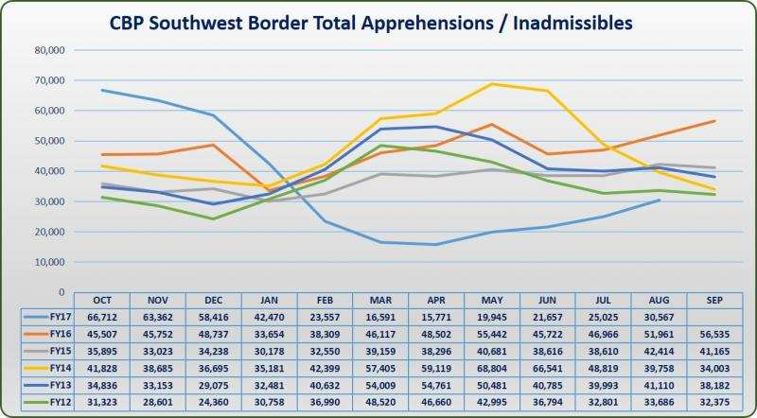
Success: Immigration
Between 2009-15, the Obama administration deported more than 2.5 million people - most of whom had been convicted of some form of criminal offence or were recent arrivals - leading some to label President Obama the "deporter-in-chief".
But an estimated 11 million undocumented immigrants still live in the US, many from Mexico.
There have been 40% fewer illegal border crossings and deportation of violent and repeat offenders under Trump compared to Obama’s final year in office. Most attribute this to the hostile rhetoric of the Trump administration discouraging border crossings.
The FY17 trend shows that the numbers were decreasing during the campaign, dramatically decreased after the election, and continued to fall and remain low during Trump’s first few months in office.
However, since April 2017 (and the usual bump during warm-weather months) the numbers have increased steadily but are still lower than they have been in recent years.
Trump signed 2 executive orders in February 2017 to toughen enforcement. Specifically, undocumented immigrants arrested for traffic violations or shop-lifting are being targeted along with those convicted of more serious crimes.

Slide 27
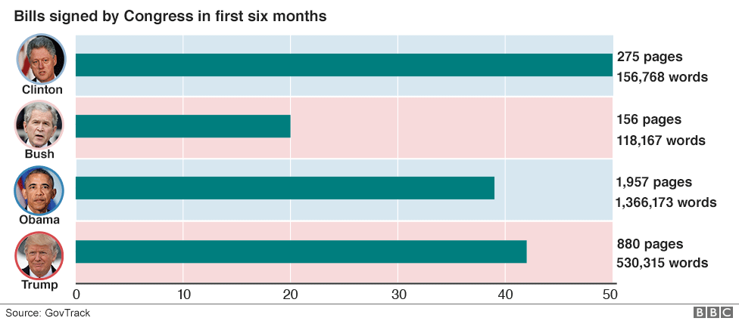
Success: Passing Bills
While Trump has signed dozens of bills into law (but less than FDR and Truman who passed 76 and 55 respectively during their first 100 days) none of those bills were “major” or “signature” legislation.
One bill changed the name of a Veterans Affairs outpatient clinic in Pago Pago, American Samoa; another renamed a VA health center in Pennsylvania; another approves the location of a memorial honoring Desert Storm and Desert Shield veterans; three appointed citizen regents to the board of the Smithsonian Institution.
Over a dozen bills were signed nullifying federal regulations enacted during the Obama administration (such as H.J. Res. 69, reversing a U.S. Fish and Wildlife rule pertaining to Alaska’s National Wildlife Refuges and S.J. Res. 34, reversing FCC Internet privacy rules) under the Congressional Review Act of 1996, which imposes a 60-day limit on the time allowed to overrule previously passed laws.
Still, simply passing bills will likely not be enough to persuade the American people of legislative success when zero major bills have been passed.

Slide 28
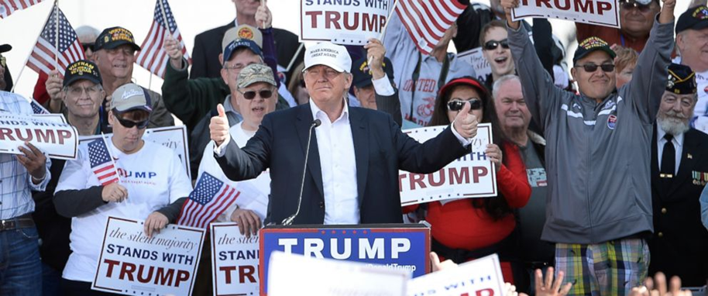
Success: Anti-Establishment Politics
The most important “success” for Trumpists is simply the fact that he is president.
For these supporters, Trump is the embodiment of the honest, plain-spoken, crusading outsider who is shaking up the system.
Any “failures” he may have as president or “shortcomings” about him personally are irrelevant because they are all born from an “establishment” that is under attack and will say or do anything to hold on to power.
The question: is this enough to define success? Should the American people expect more?

Slide 29
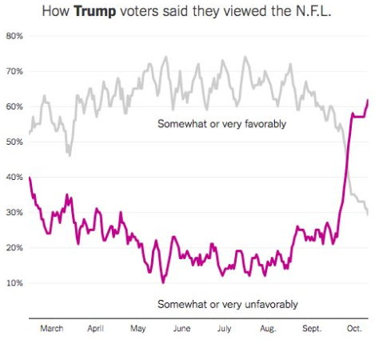
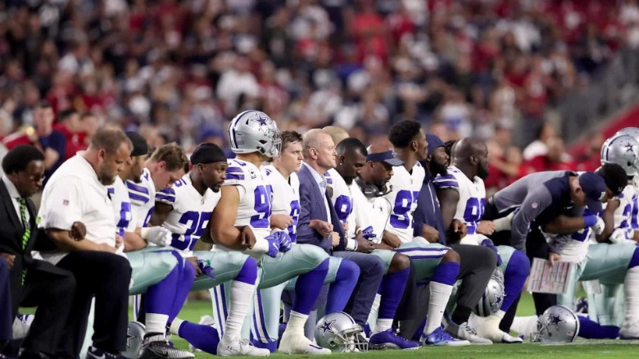
Trump’s Base is Solid
Not only is Trump’s base of core supporters solidly behind him, they believe what he says and will follow his views no matter what they are.
Consider that Trump voters completely switched their view of the National Football League (NFL) once Trump started criticizing it over national anthem protests.

Slide 30
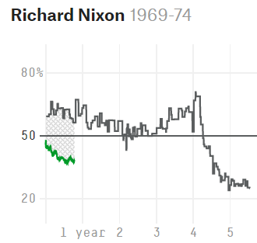
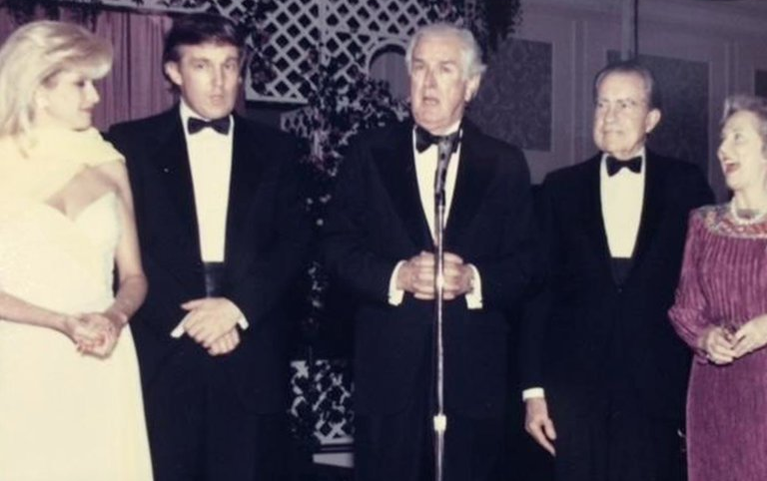
Questions
Scandals can derail a presidency regardless of policy or political achievements (e.g. Nixon).
Will the Russia scandal so damage Trump that his successes will not matter to the American people?
Consider Nixon: even after the House Judiciary Committee voted to impeach him, losing the support of virtually all congressional Republicans, and resigning over Watergate, Nixon still had a 25% approval rating.
Thus, no mater what Trump does or does not do, he can probably count on at least a quarter of the American people to support him.
Will that be enough for him to win reelection in a race with 3 or 4 major candidates? Lincoln was elected in 1860 with only 39.8% of the popular vote.

Slide 31
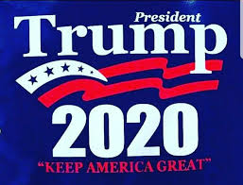
Conclusion
If we judge Trump’s progress by the absurd standards he himself set out on the campaign trail—like “immediately repealing and replacing the disaster known as Obamacare”—he is undoubtedly falling behind.
But if we judge him by a more objective standard, it becomes clear that he has indeed succeeded in making some very significant changes in his first year in office.
It remains to be seen whether Trump will be able to build on his successes as his term progresses or whether his failure to live up to his lofty campaign promises will matter.
Trump may only have less than one year left to take advantage of the relatively favorable political arrangement of the GOP controlling all branches of government.
The congressional midterm elections are nearing and presidential candidates will begin announcing their candidacies in the months after that.
If the Democrats retake the House, they will begin impeachment hearings in Jan. 2019.

Slide 32
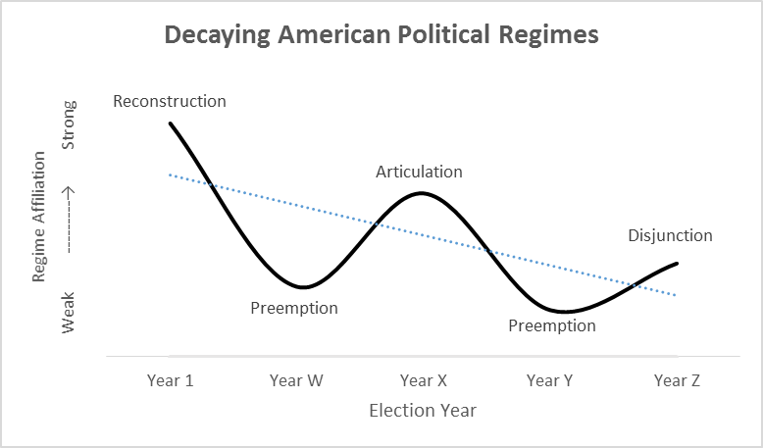

Slide 33
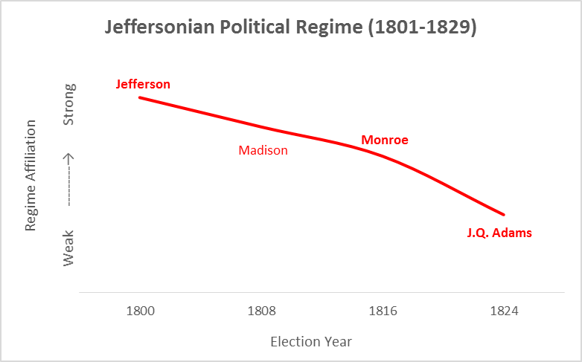

Slide 34
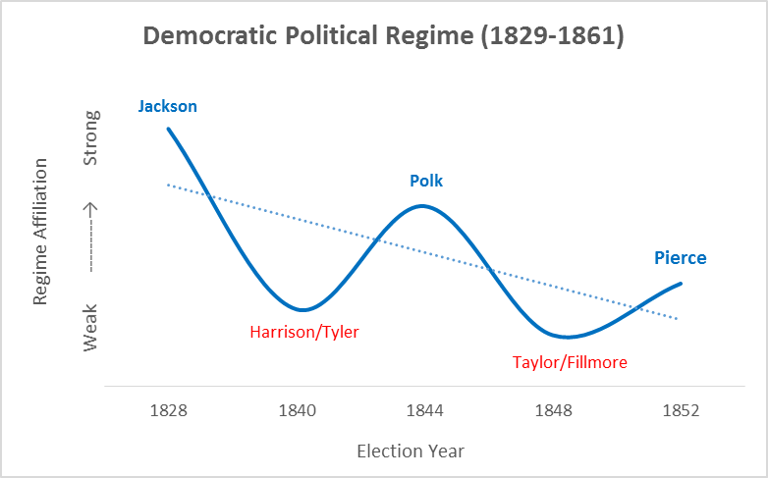

Slide 35
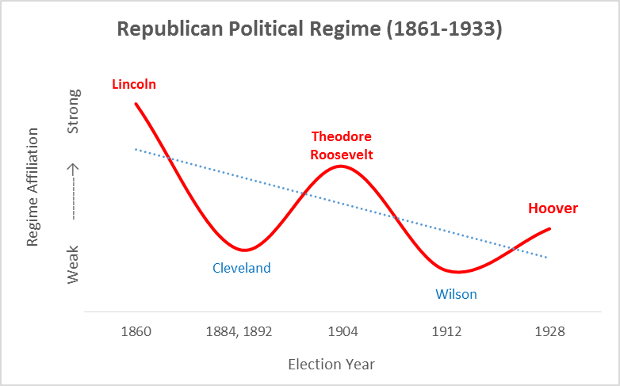

Slide 36
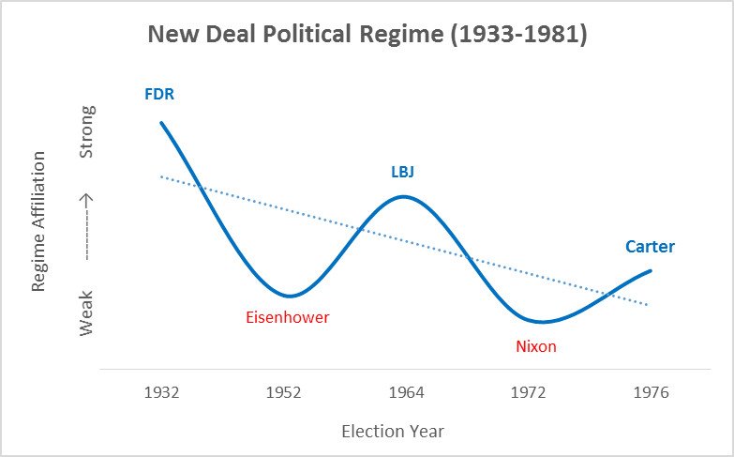

Slide 37
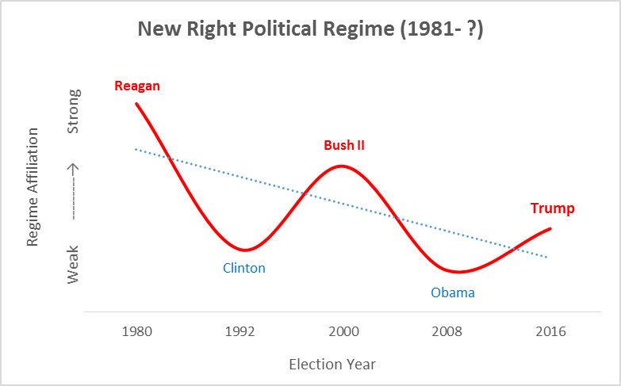

Slide 38
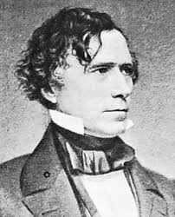
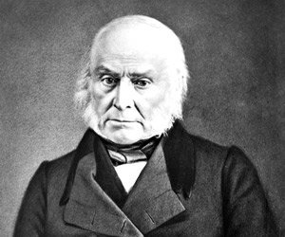
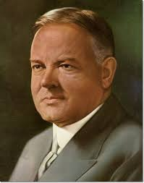
American Political Regimes: Disjunction
Elected toward the end of a political regime, disjunctive presidents are nominally affiliated with the regime (and the reconstructive and articulative presidents who came before them) and preside over the regime’s downfall as the ideological commitments of the regime are called into question and the coalition of interests that held the regime together becomes untenable.
Disjunctive presidents are generally considered among the worst in American history: John Quincy Adams, Pierce, Hoover, and Carter.

Slide 39
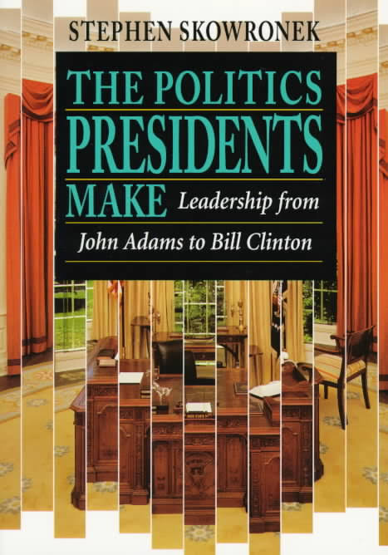
Further Reading
To learn more about the rise and fall of American political regimes and presidential leadership in political time, see:
Skowronek, Stephen, The Politics Presidents Make: Leadership from John Adams to Bill Clinton, revised ed. (New York: Belknap Press, 1997).
Skowronek, Stephen, Presidential Leadership in Political Time: Reprise and Reappraisal, 2nd ed. (Lawrence: University Press of Kansas, 2011).
For a brief history of each American presidential election, see:
Boller, Paul F. Jr., Presidential Campaigns: From George Washington to George W. Bush (New York: Oxford University Press, 2004).

